Slide 1
EagleSat 2:
On-Board Computer Subsystem
David Stockhouse
Arizona Space Grant Symposium
April 14, 2018

Slide 2
Overview
System-level description of satellite
Computational needs for each subsystem
On-board computer subsystem architecture
In-depth look at payload prototypes
Next Steps

Slide 3
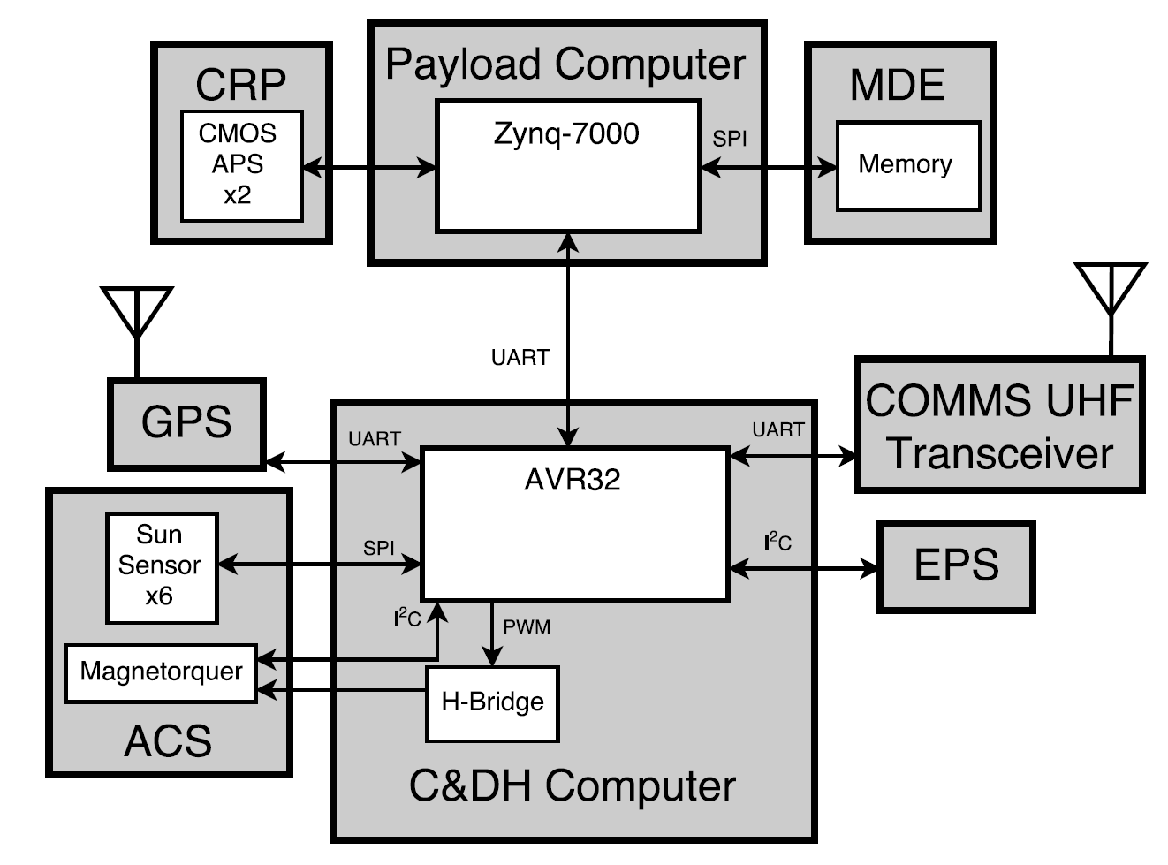
System-Level Description

Slide 4
Computational Needs – Bus Systems
Communications – Command reception and data transmission
EPS – Power monitoring
ACS – Attitude telemetry and control
GPS – Position telemetry

Slide 5
Computational Needs – Payloads
Cosmic Ray Payload (CRP)
  Interfacing with CMOS image sensor
  Image processing to determine energy and trajectory of particle events observed
Memory Degradation Experiment (MDE)
  Interfacing with several SPI memory chips
  Identifying and characterizing memory errors

Slide 6
OBC Subsystem Architecture
Two separate computer systems
Payload Computer
  Interfaces to payload hardware and processes data
  Will be designed and built in-house based on Zynq-7000 SoC
Command and Data Handling Computer
  Interfaces to other subsystems and status telemetry instruments
  Commercial off the shelf GOMSpace Nanomind A3200

Slide 7
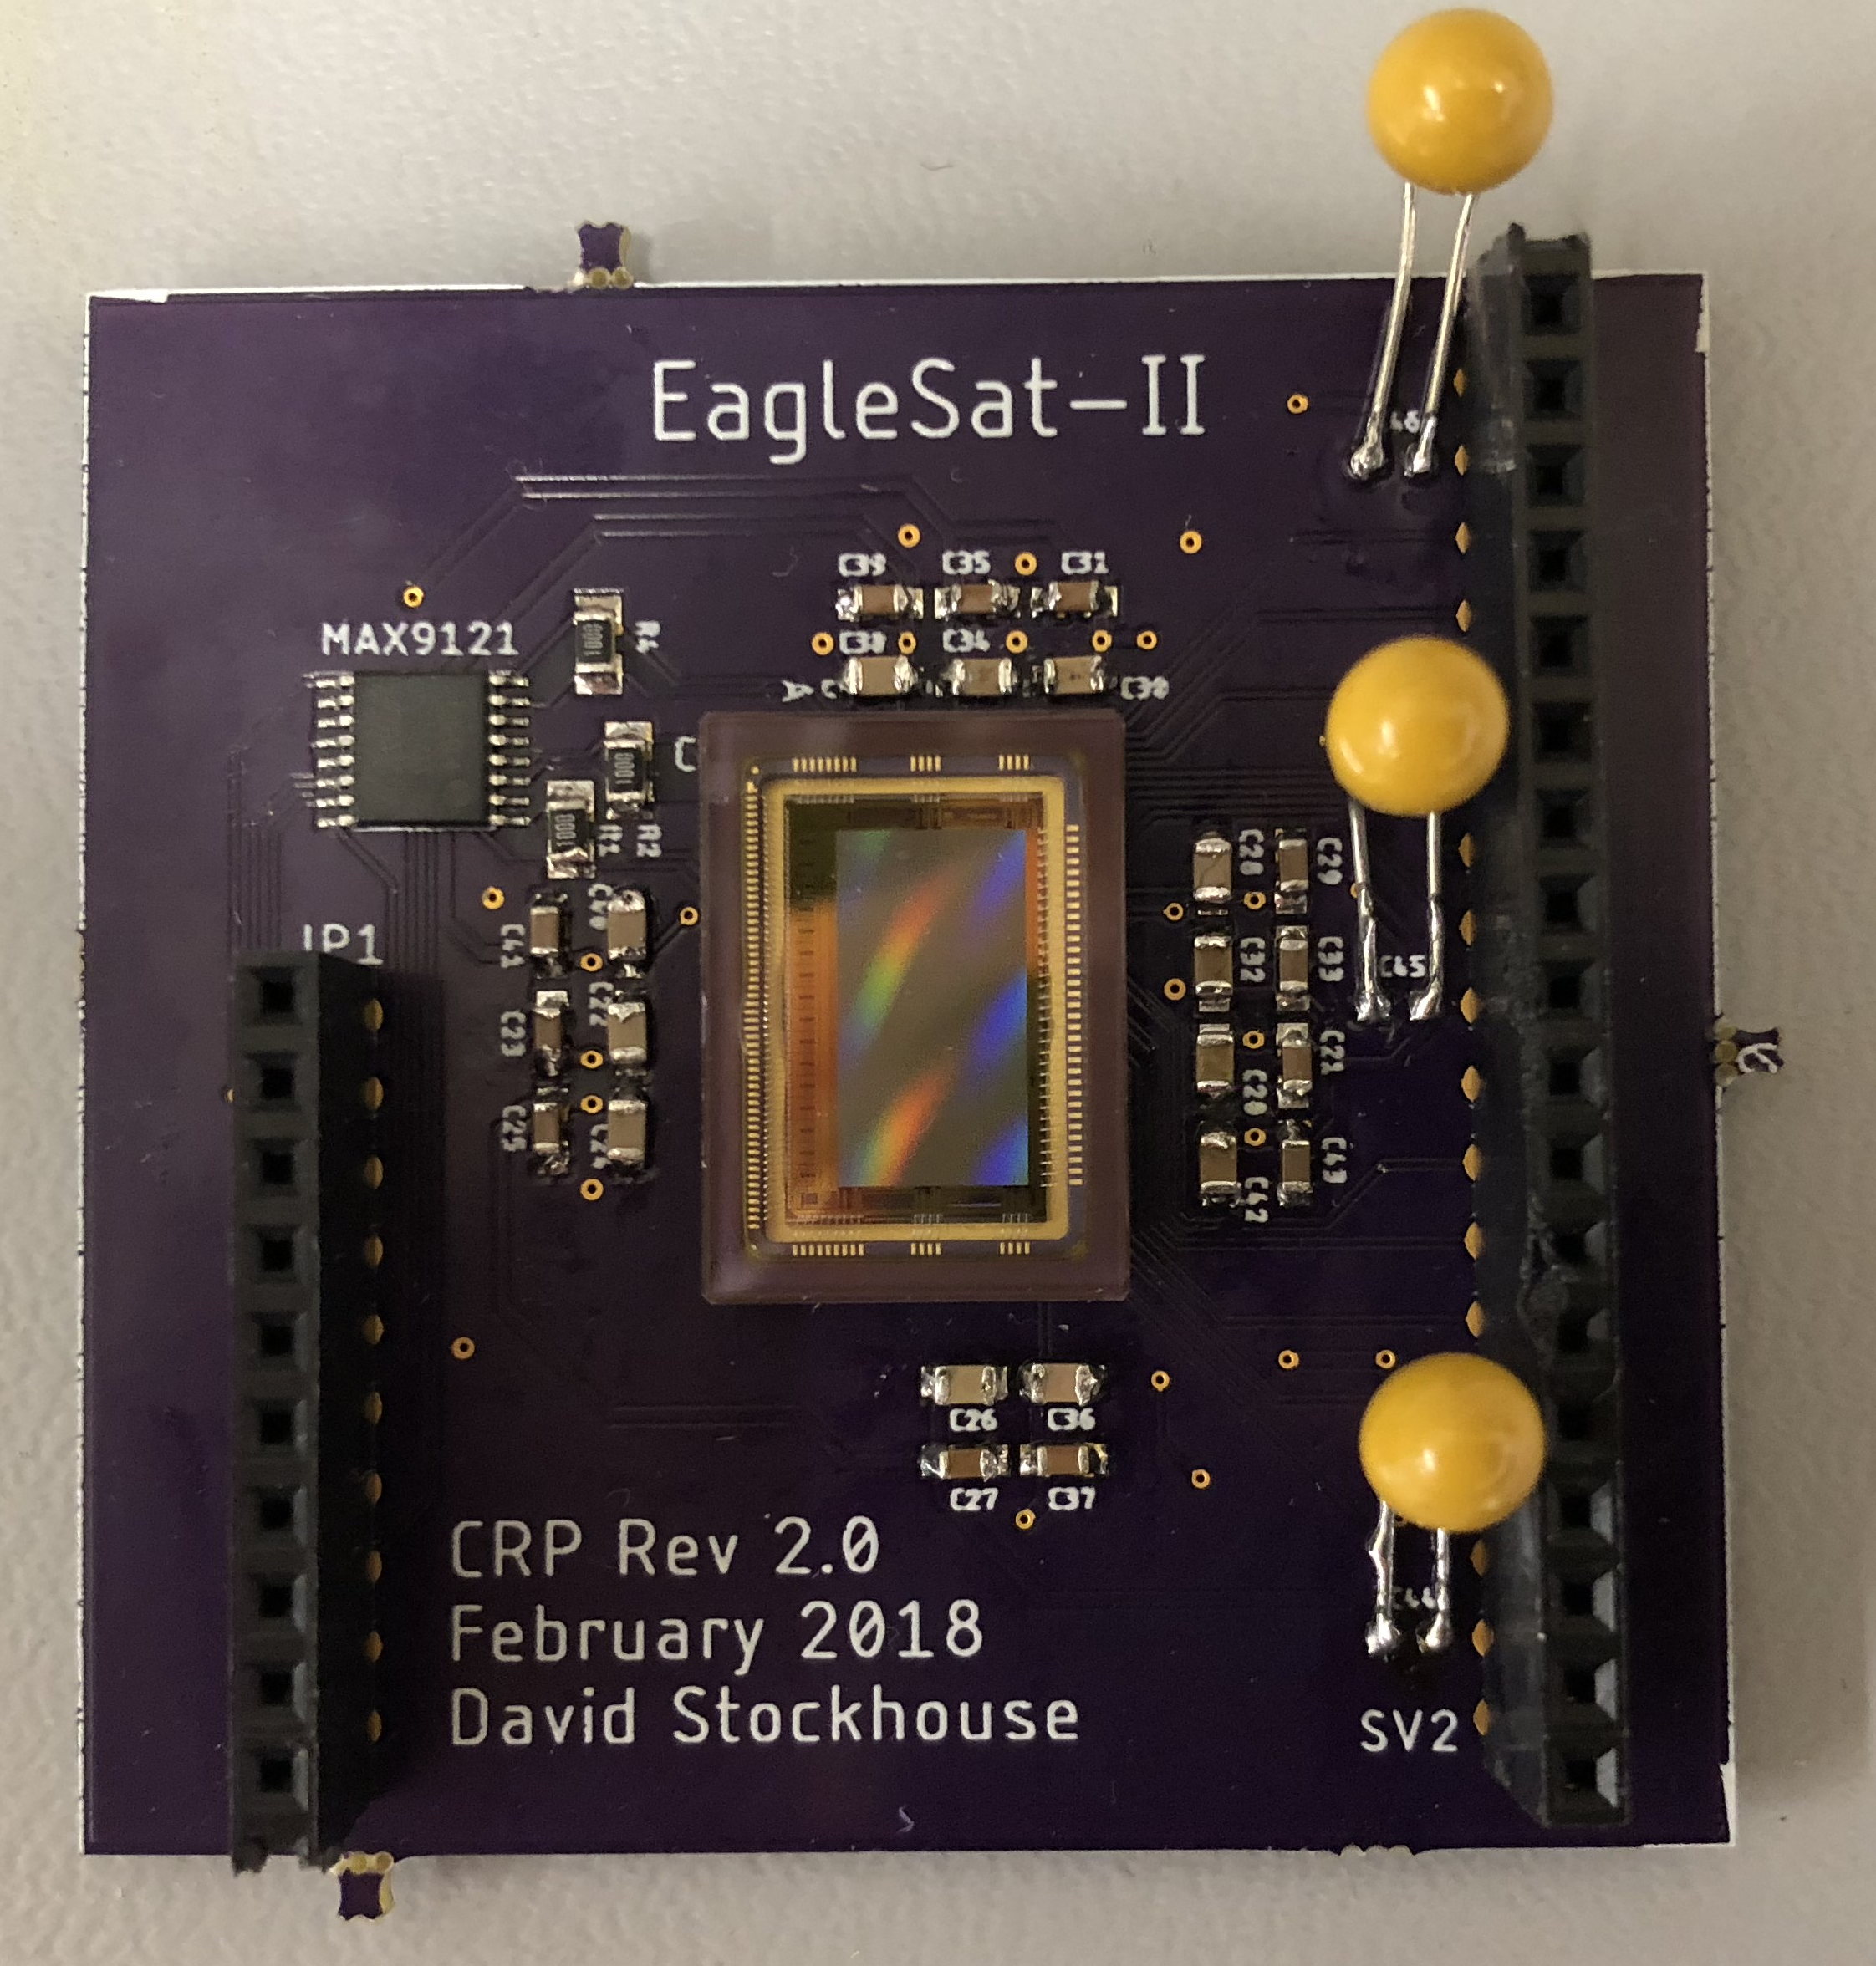
Payload Prototype – CRP
Developed on Avnet Zedboard
  Zynq-7000 contains both ARM processor system and FPGA programmable logic
  Xillybus interface between processor and FPGA
  Xillinux Linux distribution with application code on processor system
  FPGA design integrated with Xillybus IP
Uses CMV2000 CMOS image sensor
  Breakout board designed in-house
  Complete system design and testing is ongoing

Slide 8
Payload Prototype – MDE
Developed on Texas Instruments TM4C123GXL
Memory board developed in-house
Testing ongoing since February

Slide 9
Next Steps
Miniaturizing CRP prototype
High altitude balloon test flight
Payload prototypes on fully custom PCBs
More capable flight hardware

Slide 10
Acknowledgements
Embry-Riddle College of Engineering
NASA Space Grant
Dr. Gary Yale – Faculty Supervisor
Dr. Brian Davis
Dr. Akhan Almagambetov

Slide 11
Thank You
David Stockhouse
EagleSat 2 On-Board Computer Lead
stockhod@my.erau.edu
Questions?

Slide 12
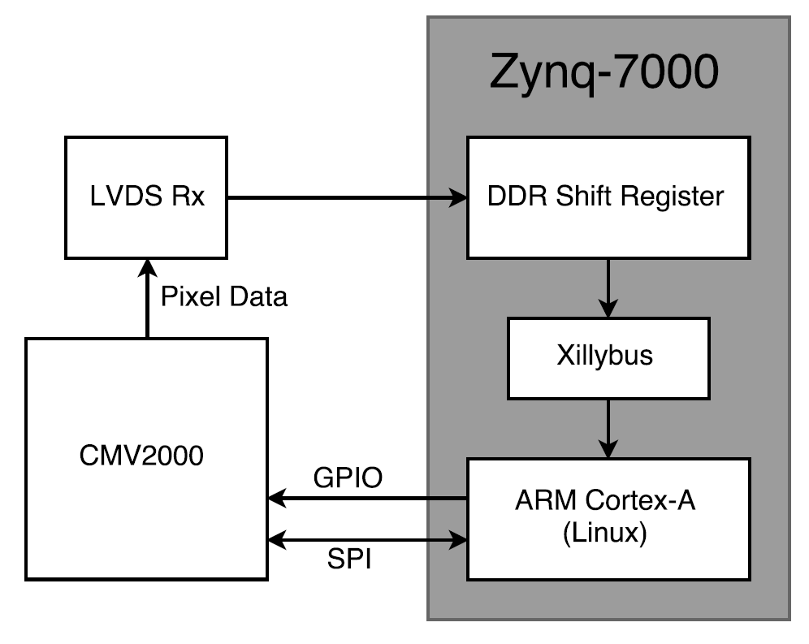
Backup Slide
CRP Prototype Block Diagram

